Slide 1

Exercise Sheets

Slide 2
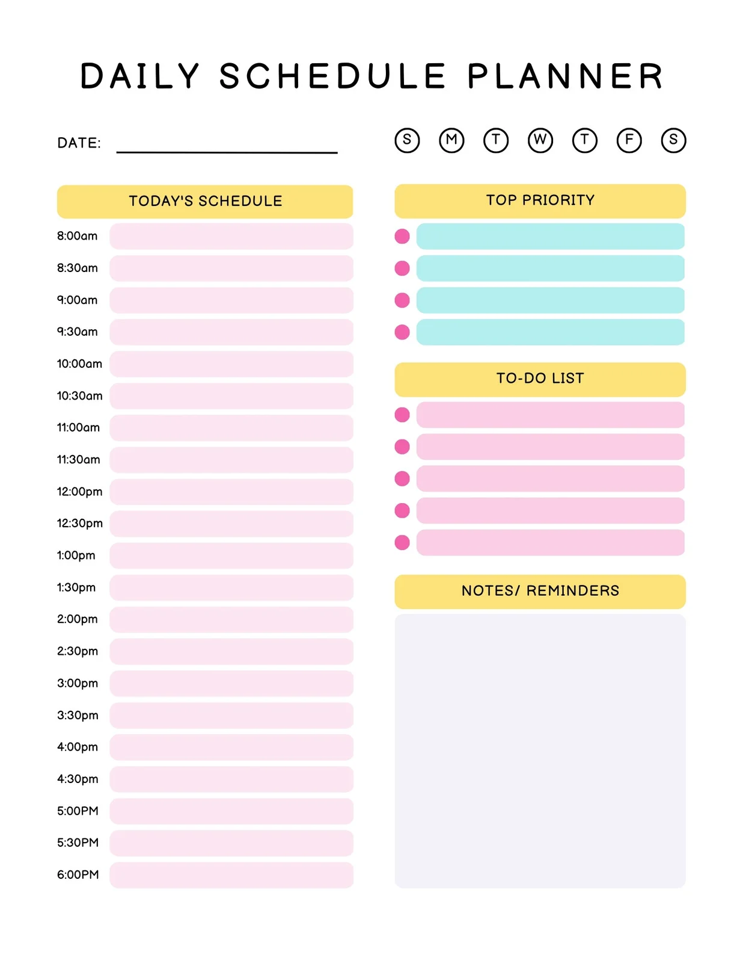
Time Management Tool 1: Finding your Hybrid Flow (Example)
Staff Meeting
Clinet Meeting
1-1 with Colleague
Update your Boss
Flow Zone

Slide 3
Time Management Tool 1: Finding your Hybrid Flow (Example)
Flow Zone
Staff Meeting
Client Meeting
1-1 with Colleague
Update your Boss

Slide 4
Time Management Tool 1: Finding your Hybrid Flow
Exercise Sheet

Slide 5
Time Management Tool 1: Finding your Hybrid Flow
Exercise Sheet

Slide 6
Time Management Tool 2: Your Most Valuable Activities Instructions
Discover Your MVAs
Directions: This worksheet is designed to help you identify your most valuable activities.
1st Column: List each activity that you perform at work.
2nd Column: Rate how talented you believe you are in each activity on a scale of 0 to 10 where 0 represents no talent and 10 represents highly talented.
3rd Column: Rate how easy it would be to replace you for each activity, where 0 represents very easy to find and hire someone else and 10 represents nearly impossible to replace.
4th Column: Using your best judgment, rank each work activity in terms of most value.
5th Column: After you create the ranks, get your top two most valuable activities and then estimate what percent of your work time you spend doing them. The more time you spend in these activities, the more valuable to the marketplace you become.

Slide 7
Time Management Tool 2: Your Most Valuable Activities (MVAs) (Example)
Discover Your MVAs
Work Activities | Strength | Replace | Rank | Total Hours/Week % of Work Time
Make ppt presentations
10
5
7
Conduct Trainings
10
10
1
20 or 50%
Develop New Courses
9
8
5
Gather and Interpret Training Feedbacks
9
7
6
Research New Training Methods
9
8
4
Conduct Training Needs Analysis
10
8
3
Prepare educational material such as module summaries, videos etc.
10
9
2
10 or 25%

Slide 8
Time Management Tool 2: Your Most Valuable Activities (MVAs) (Exercise Sheet)
Discover Your MVAs
Work Activities | Strength | Replace | Rank | Total Hours/Week % of Work Time

Slide 9
Time Management Tool 2: Your Most Valuable Activities (MVAs) (Exercise Sheet)
Discover Your MVAs
Work Activities | Strength | Replace | Rank | Total Hours/Week % of Work Time

Slide 10
Time Management Tool 3: Individual Calendar Planning
(Example)
TIME | MONDAY | TUESDAY | WEDNESDAY | THURSDAY | FRIDAY
8:00 |  |  |  | (I) Admin Work
8:30 | (C) Weekly Check-in |  | (I) Project Report |  | (I) Project Report
9:00 |  | (C) Team Meeting
9:30
10:00 | Check Email | Check Email | Check Email | Check Email | Check Email
10:30 | Check Email | Check Email | Check Email | Check Email | Check Email
11:00 |  |  |  | (C) Client Presentation
11:30
12:00
12:30
1:00 |  | (I) Tasks Using Systems in the Office | (C) Program Proposal Update | (I) Focus on Work Tasks | (I) Project Report
1:30 | (I) Admin Work
2:00
2:30
3:00 | Check Email | Check Email | Check Email | Check Email | Check Email
3:30 | Check Email | Check Email | Check Email | Check Email | Check Email
4:00 | (C) Feedback on Task Delivery | (I) Tasks Using Systems in the Office | (C) Review of Objectives and Key Results | (C) Brainstorming | Plan For Next Week
4:30
5:00

Slide 11
Time Management Tool 3: Individual Calendar Planning
(Template)
TIME | MONDAY | TUESDAY | WEDNESDAY | THURSDAY | FRIDAY
8:00
8:30
9:00
9:30
10:00
10:30
11:00
11:30
12:00
12:30
1:00
1:30
2:00
2:30
3:00
3:30
4:00
4:30
5:00

Slide 12
Time Management Tool 3: Individual Calendar Planning
(Exercise Sheet)
TIME | MONDAY | TUESDAY | WEDNESDAY | THURSDAY | FRIDAY
8:00
8:30
9:00
9:30
10:00
10:30
11:00
11:30
12:00
12:30
1:00
1:30
2:00
2:30
3:00
3:30
4:00
4:30
5:00

Slide 13
Time Management Tool 3: Individual Calendar Planning
(Exercise Sheet)
TIME | MONDAY | TUESDAY | WEDNESDAY | THURSDAY | FRIDAY
8:00
8:30
9:00
9:30
10:00
10:30
11:00
11:30
12:00
12:30
1:00
1:30
2:00
2:30
3:00
3:30
4:00
4:30
5:00

Slide 14
When – Where – What Collaboration Tool (Example)
What to Accomplish
• Spark maximum brainstorming/interaction
• Make critical decisions
• Build maximum culture and community
Same Time
What to Accomplish
• Deadline coming; must assemble quickly virtually
• Nature of work requires many real-time connects
• Lots of show-and-tell needed
Same Location
Different Location
What to Accomplish
• Colocation for resource sharing
•Colocation for sense of community
• Work requires colocation, done in shifts
What to Accomplish
• Global team; hard to assemble
• Complex work requires individual think time
• Nature of work requires lots of iterations
Different Time

Slide 15
When – Where – What Collaboration Tool (Exercise Sheet)
What to Accomplish
Same Time
What to Accomplish
Same Location
Different Location
What to Accomplish
What to Accomplish
Different Time

Slide 16
Setting up your Gathering Point
Exercise Sheet
How Many? | Gathering Point
 | Total
 | Target

Slide 17
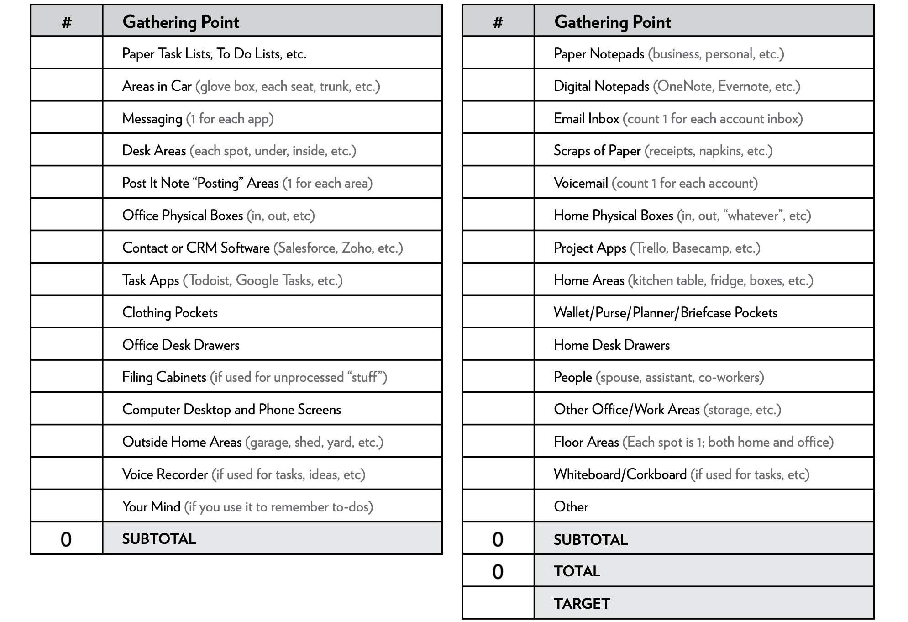

Slide 18
Approved Gathering Points: Exercise
Inbox: What 1 large inbox will you use at your workspace?
Portable Inbox: How will you gather unprocessed items when away from your workspace?
Notepad: Will you use a digital or a paper notepad? Which one tool will you use?
Email Inbox: Which one email app will you use? Can you combine multiple email addresses into one email inbox?
Messaging: What is your primary messaging tool? Do you need an “emergency channel” as well?
Wildcard: Do you need a “wildcard” gathering point? Examples include: two of any of the five listed above, voicemail, project apps, social media inboxes, etc.
Notes:
18

Slide 19
Hybrid Excellence Learning Plan (HELP)
TOPICS | COMMITMENT (1-10) | ACTION PLAN (Steps to take)
TIME MANAGEMENT TOOLS
A. Find your Hybrid Flow
B. Identify your MVAs
C. Create your Individual Calendar Plan
COLLABORATION TOOL
A. When-Where-What Matrix

Slide 20
Hybrid Excellence Learning Plan (HELP)
TOPICS | COMMITMENT (1-10) | ACTION PLAN (Steps to take)
PRODUCTIVITY TOOLS
A. Setting up your Gathering Points
LEVERAGING TECH TOOLS
5-Point Tech Check Security Collaboration Communication Connectedness Productivity

